Slide 1


Albert Sicart Avalos
2023-09-13

Slide 2

Outline
Executive Summary
Introduction
Methodology
Results
Conclusion
Appendix

Slide 3
Executive Summary
Summary of methodologies: We will collect public data from SpaceX API and SpaceX Wikipedia page. We will create new labels such as “class” to classify and differentiate successful and unsuccessful landings. We eill explore the data using SQL, visualization, folium maps and dashboards. We will gather relevant columns to be used as features. We will change categorical variables using one hot encoding. We will standardize data and use GrideSearchCV to find best parameters for machine learning models. We will visualize accuracy score of all models.
Summary of all results: we produced four different machine learning models that will predict with nearly 83% of accuracy, including Logistic Regression, Support Vector Machine, Decision Tree Classifier and K Nearest Neighbors. Nonetheless further data is needed to enhance the model.

Slide 4
Introduction
Project background and context: Space X advertises Falcon 9 rocket launches on its website with a cost of 62 million dollars; other providers cost upward of 165 million dollars each, much of the savings is because Space X can reuse the first stage. Therefore if we can determine if the first stage will land, we can determine the cost of a launch. This information can be used if an alternate company wants to bid against space X for a rocket launch.
Problems you want to find answers: We want to predict when the launch will be successful or not, thus if the first stage lands successfully the company could save up to 100 million dollars.

Slide 5

Section 1

Slide 6
Methodology
Executive Summary
Data collection methodology:
We extracted the data from SpaceX public API and SpaceX Wikipedia.
Perform data wrangling
We classified true landings as successful and unsuccessful otherwise.
Perform exploratory data analysis (EDA) using visualization and SQL
Perform interactive visual analytics using Folium and Plotly Dash
Perform predictive analysis using classification models
Tuned Models using GridSearchCV

Slide 7
Data Collection
We’ve collected data using Api request from Space X public API and, after that, we used data scraping to get access from a table in the wiki’s entry of Space X.
From both sites we got different datasets that can be wrangled because they share similar columns:
Space X API Data Columns: FlightNumber, Date, BoosterVersion, PayloadMass, Orbit, LaunchSite, Outcome, Flights, GridFins, Reused, Legs, LandingPad, Block, ReusedCount, Serial, Longitude, Latitude.
Wikipedia Space X entry Data Columns: Flight No., Launch Site, Payload, PayloadMass, Orbit, Customer, Launch outcome, Version Booster, Booster Landing, Date, Time

Slide 8
Data Collection – SpaceX API
Request(Space X APIs)
Filter data to only include Falcon 9 launches
Imputate missing PayloadMass values with mean
Present your data collection with SpaceX REST calls using key phrases and flowcharts
Add the GitHub URL of the completed SpaceX API calls notebook (must include completed code cell and outcome cell), as an external reference and peer-review purpose:
https://github.com/AlbertSicart/MAIN/blob/main/IBM_Data_Science/Data%20Science%20Capstone/week%201/jupyter-labs-spacex-data-collection-api.ipynb
JSON file + Lists(Launch Site, Booster Version, Payload Data)
Cast dictionary into a DataFrame
Json_normalize to DataFrame data from JSON
Disctionary relevant data

Slide 9
Data Collection - Scraping
Present your web scraping process using key phrases and flowcharts
Add the GitHub URL of the completed web scraping notebook, as an external reference and peer-review purpose
https://github.com/AlbertSicart/MAIN/blob/main/IBM_Data_Science/Data%20Science%20Capstone/week%201/jupyter-labs-webscraping.ipynb
Request Wikipedia html
Cast dictionary into the DataFrame
BeautifulSoup html5lib Parser
Iterate through table cells to extract data to dictionary
Find Launch info html table
Create Dictionary

Slide 10
Data Wrangling
In the lab, an Exploratory Data Analysis (EDA) was performed to identify patterns within the dataset and to determine the appropriate label for training supervised models.
Within the dataset, there were various instances where the booster did not land successfully. At times, a landing was attempted but failed due to some mishap. For example:
"True Ocean" indicated that the landing in a specific region of the ocean was successful.
"False Ocean" denoted an unsuccessful landing in that ocean region.
"True RTLS" meant the booster successfully landed on a ground pad.
"False RTLS" signified a failed landing attempt on the ground pad.
"True ASDS" marked a successful landing on a drone ship.
"False ASDS" signaled an unsuccessful attempt to land on the drone ship.
The main objective of the lab was to translate these outcomes into training labels. A new column named 'class' was created, having a value of:
1 if the mission outcome indicated a successful landing.
0 if the landing was unsuccessful or wasn’t attempted.
So, if the "Outcome" column showed "True ASDS", "True RTLS", or "True Ocean", a value of 1 was assigned to the 'class' column. On the other hand, for "None None", "False ASDS", "None ASDS", "False Ocean", or "False RTLS", a value of 0 was assigned.
Github: https://github.com/AlbertSicart/MAIN/blob/main/IBM_Data_Science/Data%20Science%20Capstone/week%201/labs-jupyter-spacex-Data%20wrangling.ipynb

Slide 11
EDA with Data Visualization
Exploratory Data Analysis performed on variables Flight Number, Payload Mass, Launch Site, Orbit, Class and Year
Plots used:
Flight Number and Payload Mass
Flight Number and Launch Site
Payload Mass and Launch Site
Orbit and Success Rate
Flight Number and Orbit
Payload Mass and Orbit
Success Yearly Trend
Github: https://github.com/AlbertSicart/MAIN/blob/main/IBM_Data_Science/Data%20Science%20Capstone/week%202/jupyter-labs-eda-dataviz.ipynb

Slide 12
EDA with SQL
Loaded dataset into sqlite3.
Queried using Python SQL integration.
We used queries to get a better understanding of the dataset and get information about launch site names, mission outcomes, various payload sizes, booster versions, and landing outcomes.
Git hub:
https://github.com/AlbertSicart/MAIN/blob/main/IBM_Data_Science/Data%20Science%20Capstone/week%202/jupyter-labs-eda-sql-coursera_sqllite.ipynb

Slide 13
Build an Interactive Map with Folium
We used Folium maps to mark Launch Sites with successful and unsuccessful landings. Also we appointed proximity key location example (coastline).
This might help us understand why launch sites are located where they are.
Git hub: https://github.com/AlbertSicart/MAIN/blob/main/IBM_Data_Science/Data%20Science%20Capstone/week%203/lab_jupyter_launch_site_location.ipynb

Slide 14
Build a Dashboard with Plotly Dash
The Dashboard includes a pie chart and an scatter plot. Both can be selected.
The pie chart shows distribution of successful landings across all launch sites and also can be selected to show individual launch site success rates.
The scatter plot takes two inputs: all sites or individual site and payload mass on a slider between 0 and 10000kg. This can help us see how success varies across launch sites, payload mass and booster version.
Git hub:
https://github.com/AlbertSicart/MAIN/blob/main/IBM_Data_Science/Data%20Science%20Capstone/week%203/spacex_dash_app.py

Slide 15
Predictive Analysis (Classification)
Git hub:
https://github.com/AlbertSicart/MAIN/blob/main/IBM_Data_Science/Data%20Science%20Capstone/week%204/SpaceX_Machine_Learning_Prediction_Part_5.jupyterlite.ipynb
Split label column ‘Class’ from dataset
Score models on Split test set
Confusion Matrix for all Models
Fit and Transform using Standard Scaler
Use GridSearchCV on LogReg, SVM, Decission Tree, and KNN Models
Barplot to compare scores of models
Train_test_Split data
GridSearchCV (cv=10) to find optimal parameters

Slide 16
Results
Exploratory data analysis results
Interactive analytics demo in screenshots
Predictive analysis results

Slide 17

Section 2

Slide 18
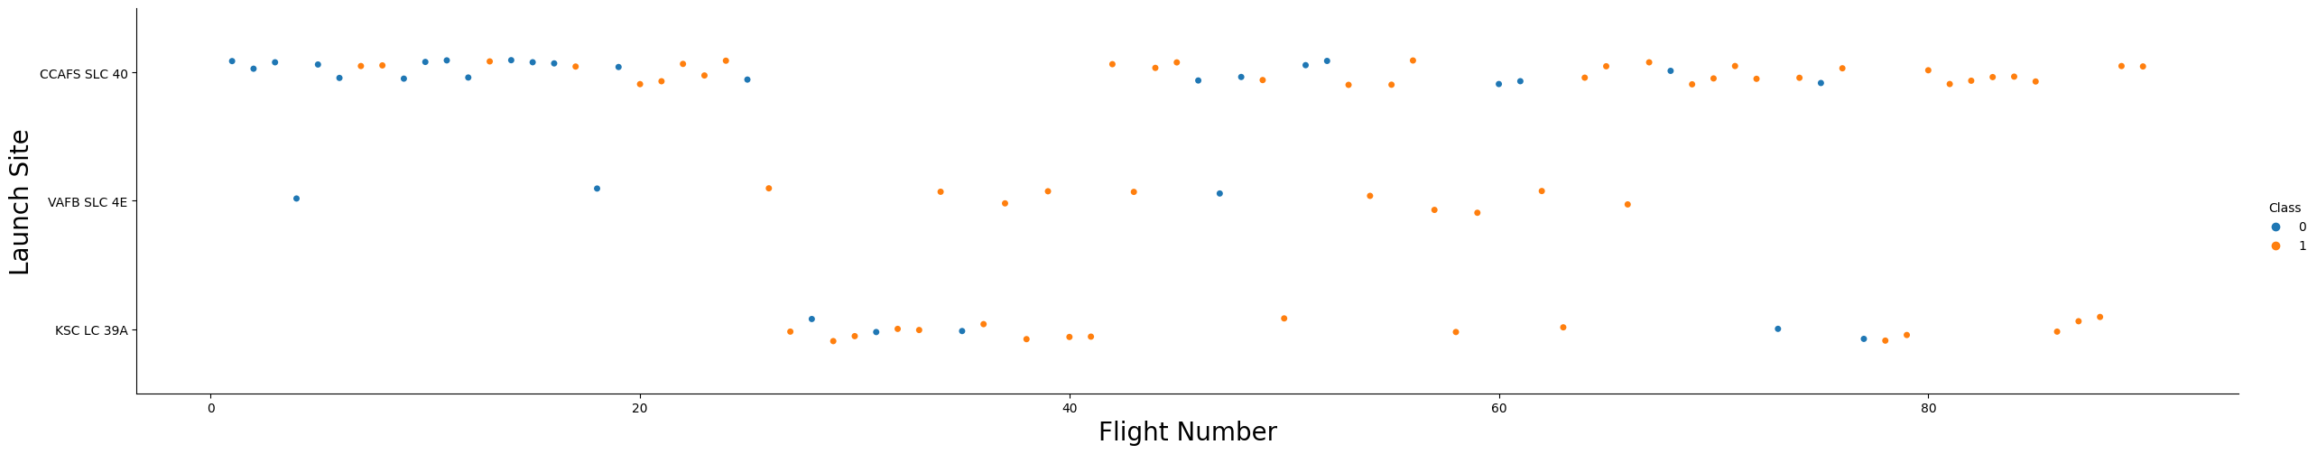
Flight Number vs. Launch Site
Orange indicates successful launch, Blue otherwise.
We can observe a gradual success rate over time from Flight Number 20.
Also, there is a preference of CCAFS as a launching site, as it contains the most data points.

Slide 19
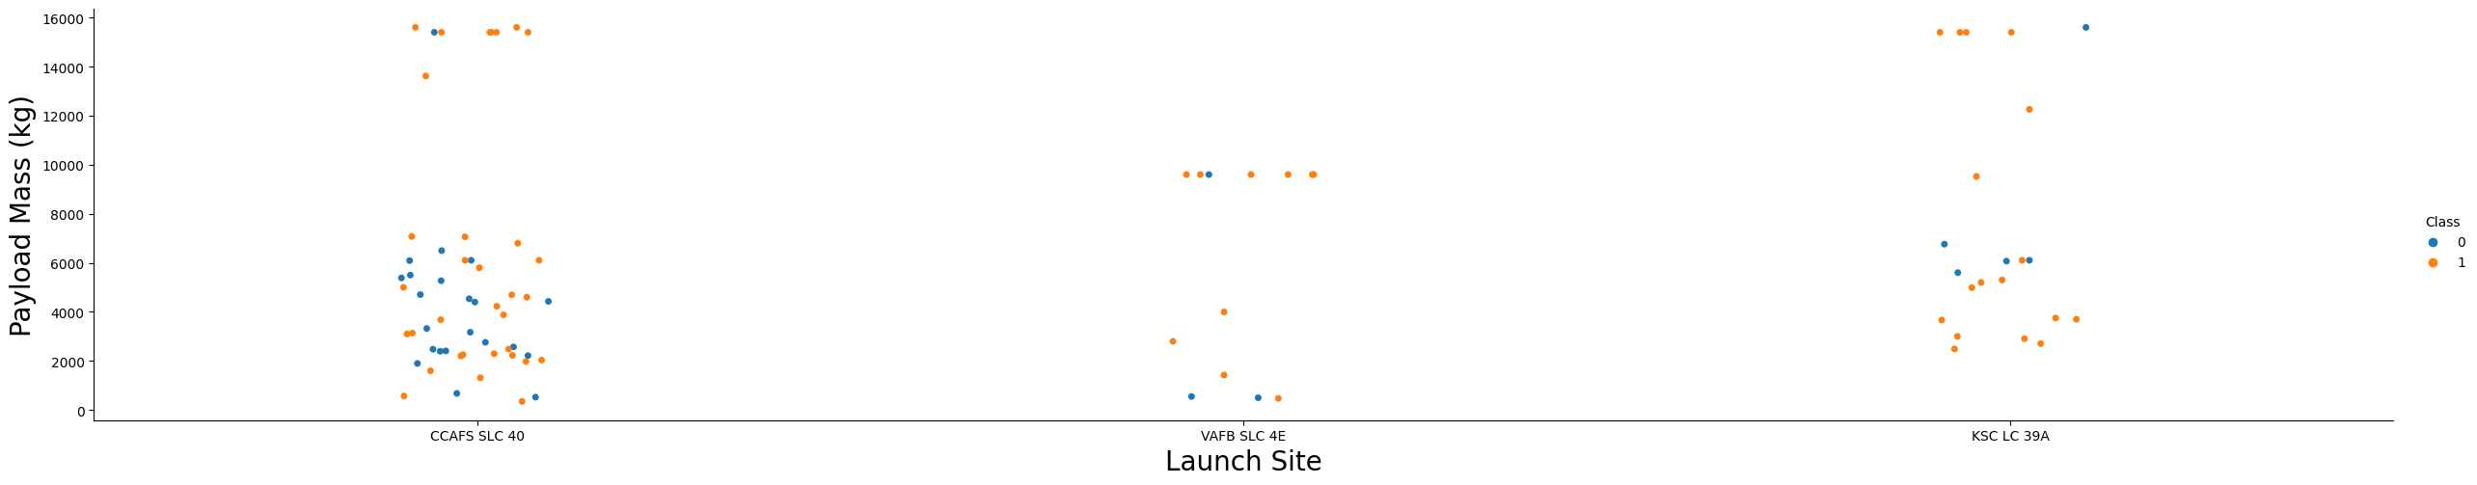
Payload vs. Launch Site
Orange indicates successful launchs, blue otherwise.
It seems that the more Payload Mass, more launch success.
There is no Heavy PayloadMass in VAFB.

Slide 20
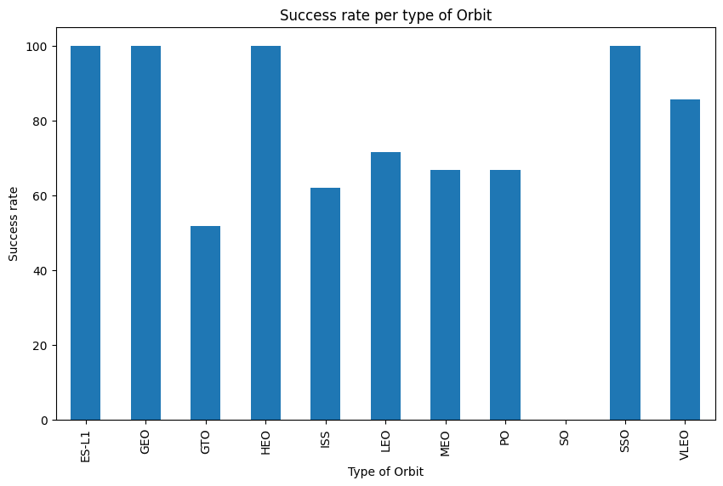
Success Rate vs. Orbit Type
ES_L1 (1), GEO(1), HEO(1) hae 100% success rate (sample sizes in parenthesis)
SSO (5) has 100% success rate
VLEO (14) has around 70% success rate
SO(1) has 0% success rate
GTO (27) has 50% success rate

Slide 21
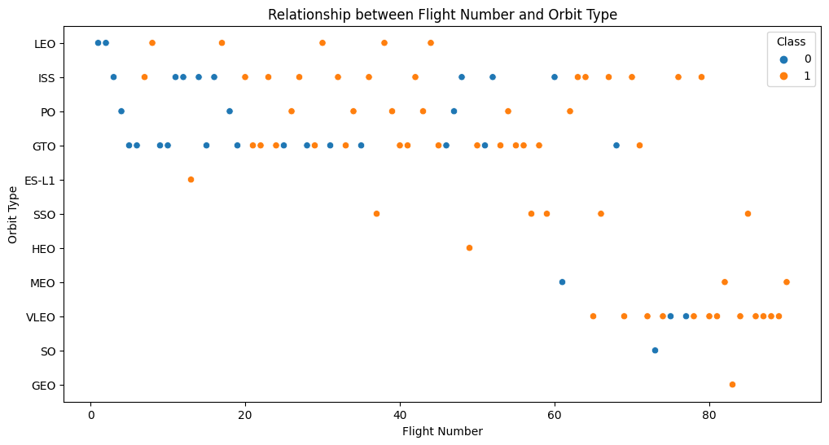
Flight Number vs. Orbit Type
Launch Orbit preferences changed over Flight Number.
Launch Outcome seems to correlate with this preference.
SpaceX started with LEO orbits which saw moderate success LEO and returned to VLEO in recent launches.
SpaceX appears to perform better in lower orbits or Sun-Syncrhonous orbits.

Slide 22
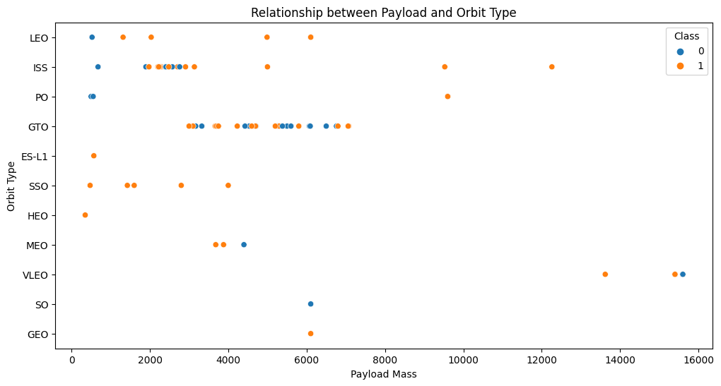
Payload vs. Orbit Type
Payload mass seems to relatively correlate with orbit
Only ISS and VLEO have a Payload mass of more than 10000kg
Most of them use a Payload Mass of les tan 8000kg

Slide 23
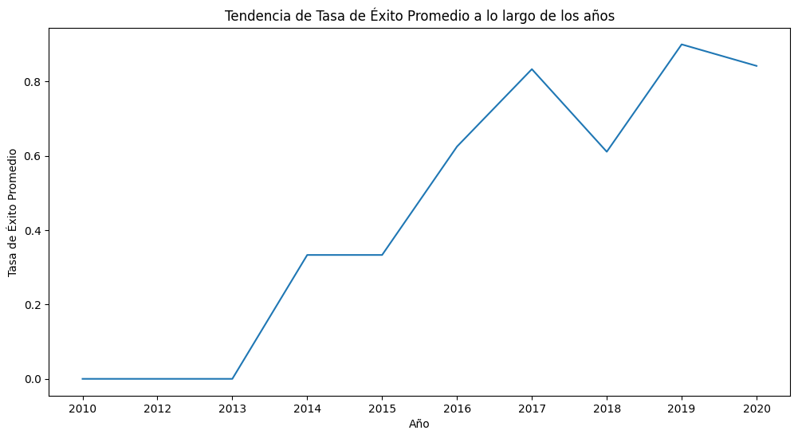
Launch Success Yearly Trend
We can see the trend of the last years incrementing and being more and more successful, achieving a 80% success rate in 2019-2020.

Slide 24
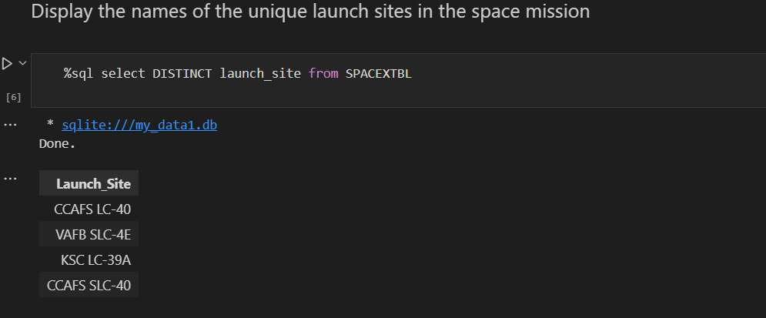
All Launch Site Names
Here are displayed the names of unique launch sites in the space mission using SQL query.

Slide 25
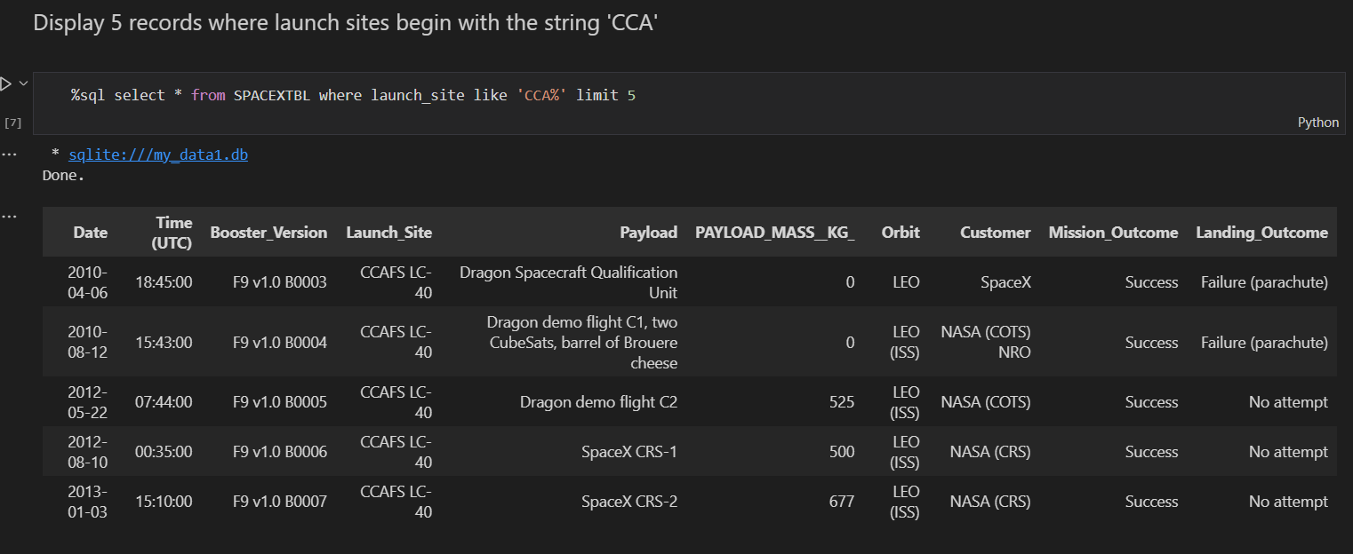
Launch Site Names Begin with 'CCA'
Here are displayed 5 records where launch sites begin with `CCA`

Slide 26
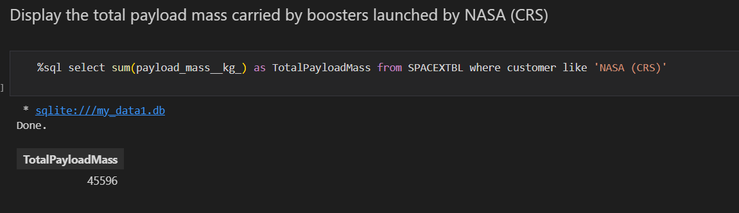
Total Payload Mass
We calculate the total payload carried by boosters from NASA

Slide 27
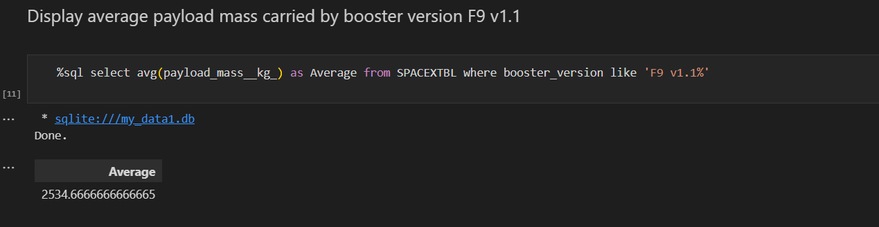
Average Payload Mass by F9 v1.1
Here is displayed the average payload mass carried by booster version F9 v1.1

Slide 28
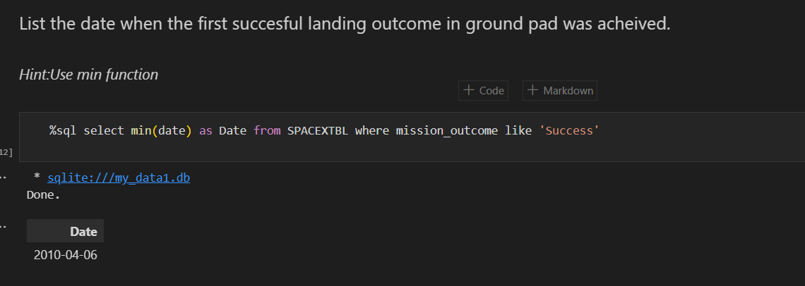
First Successful Ground Landing Date
Here are listed the date when the first successful landing was achieved

Slide 29
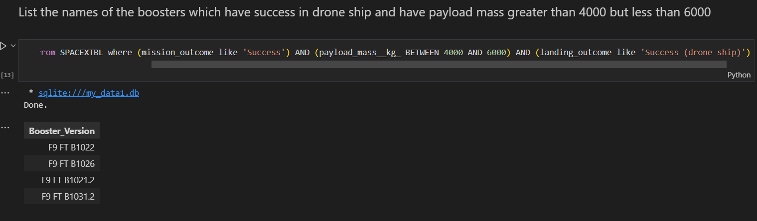
Successful Drone Ship Landing with Payload between 4000 and 6000
Here is a list of names of boosters which have successfully landed on drone ship and had payload mass greater than 4000 but less than 6000

Slide 30
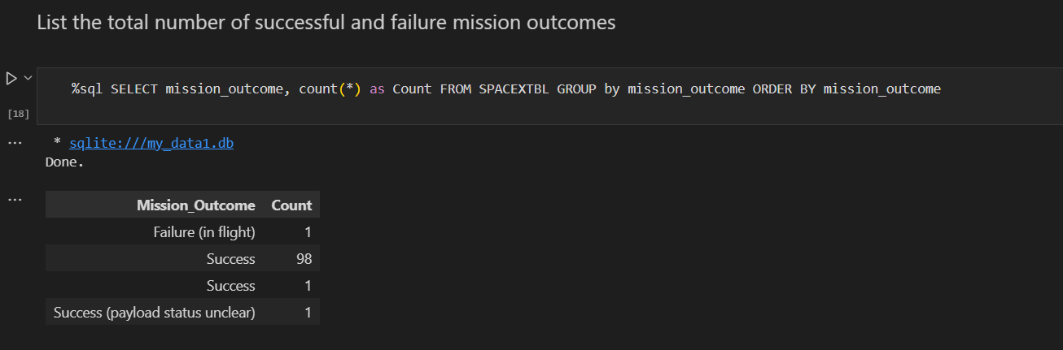
Total Number of Successful and Failure Mission Outcomes
Here is displayed the total number of successful and failure mission outcomes

Slide 31
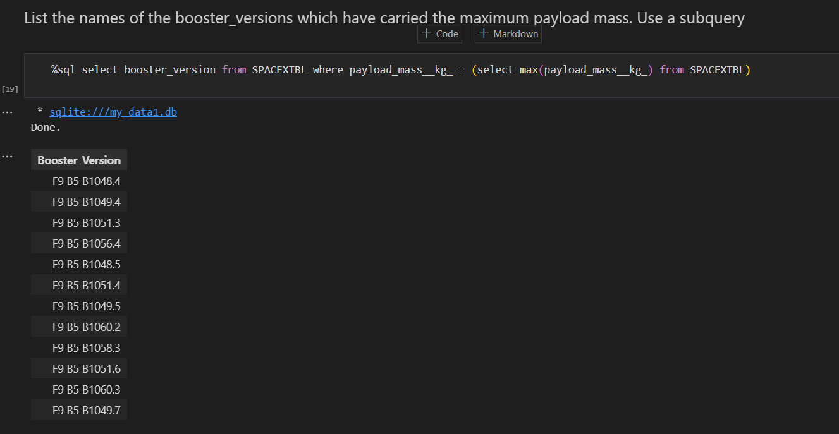
Boosters Carried Maximum Payload
Names of the booster which have carried the maximum payload mass are displayed below

Slide 32
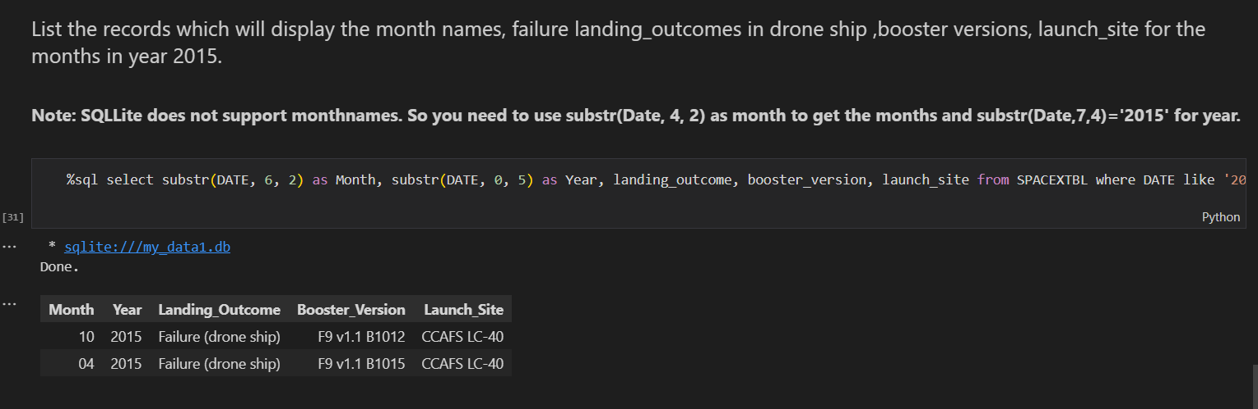
2015 Launch Records
Failed landing outcomes in drone ship, their booster versions, and launch site names for in year 2015

Slide 33
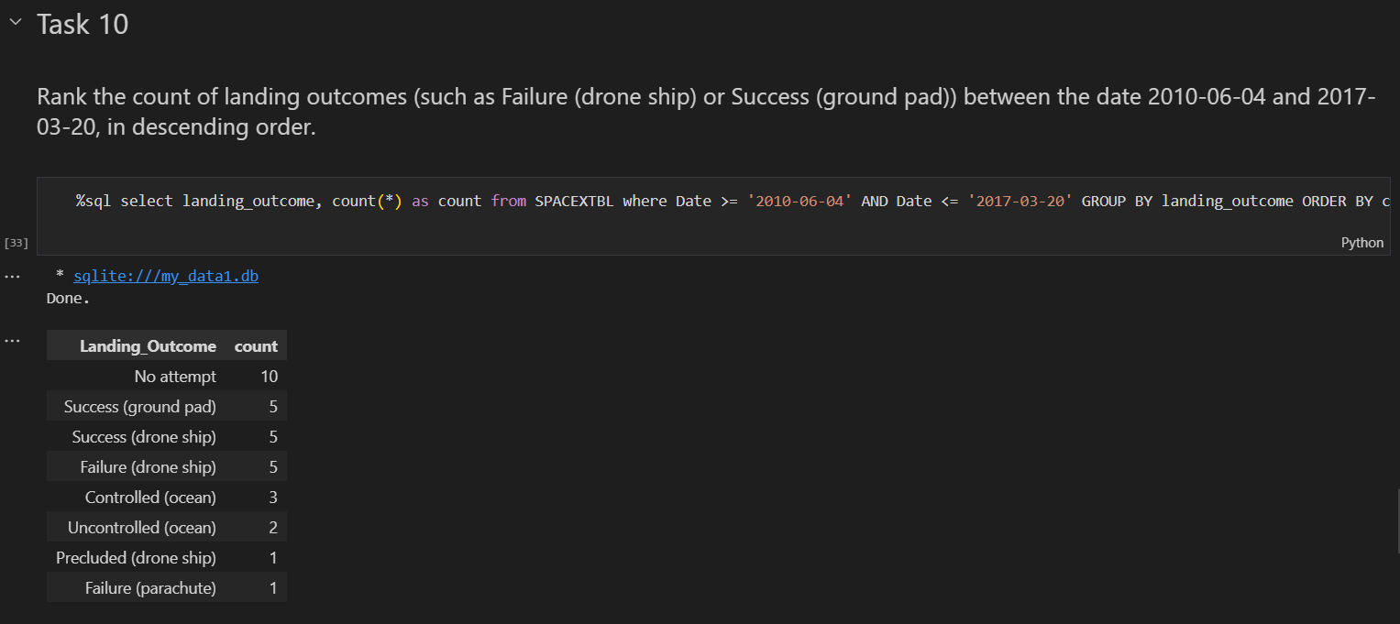
Rank Landing Outcomes Between 2010-06-04 and 2017-03-20
Ranking of landing outcomes (such as Failure (drone ship) or Success (ground pad)) between the date 2010-06-04 and 2017-03-20, in descending order

Slide 34

Section 3

Slide 35
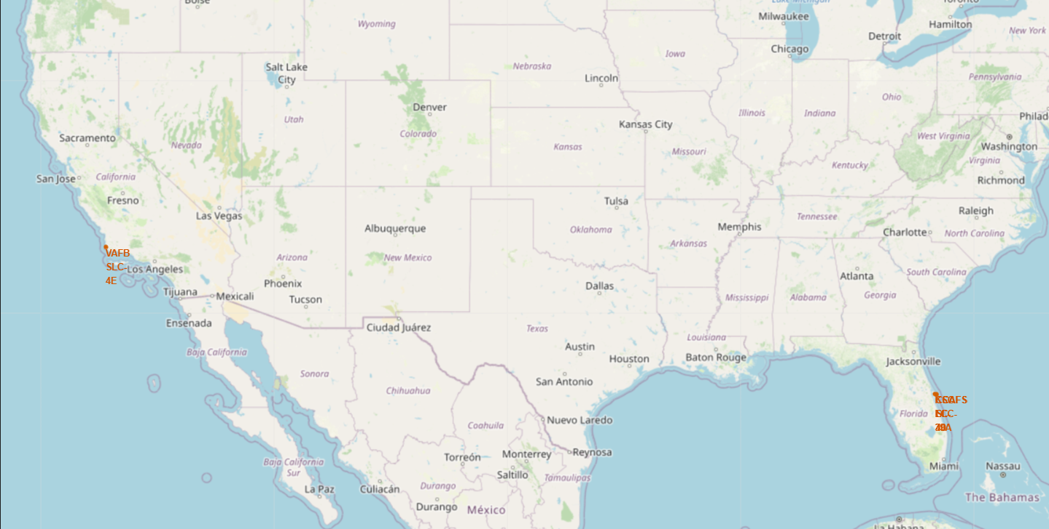
US Map Launching Sites
The map shows the emplacements of the launching sites on the map of the US. We can see that the main places are in the East and West coastline, in Florida and California respectively.

Slide 36
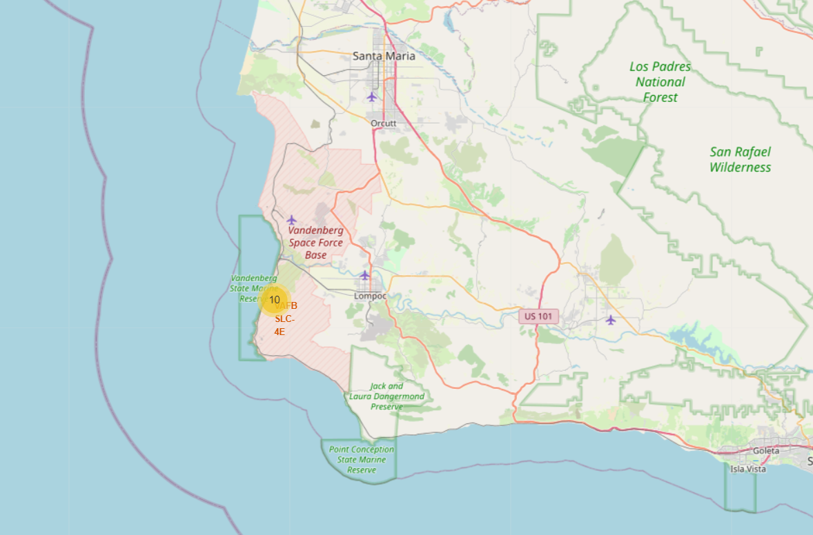
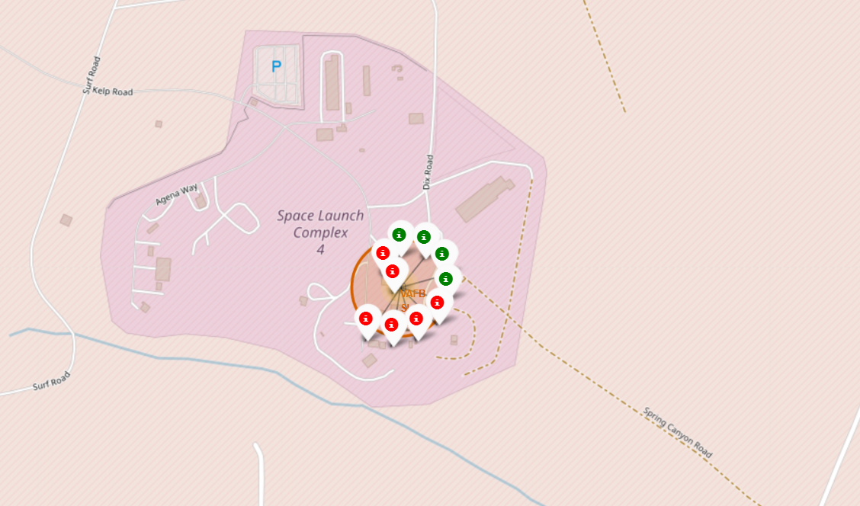
Color-Coded Launch Markers
The marker clusters on Folium can be clicked to reveal each successful (green) and failed (red) landing. In this example, In the Space Launch Complex 4 of the VAFB we can see 6 failed attempts and 4 successful attempts.

Slide 37
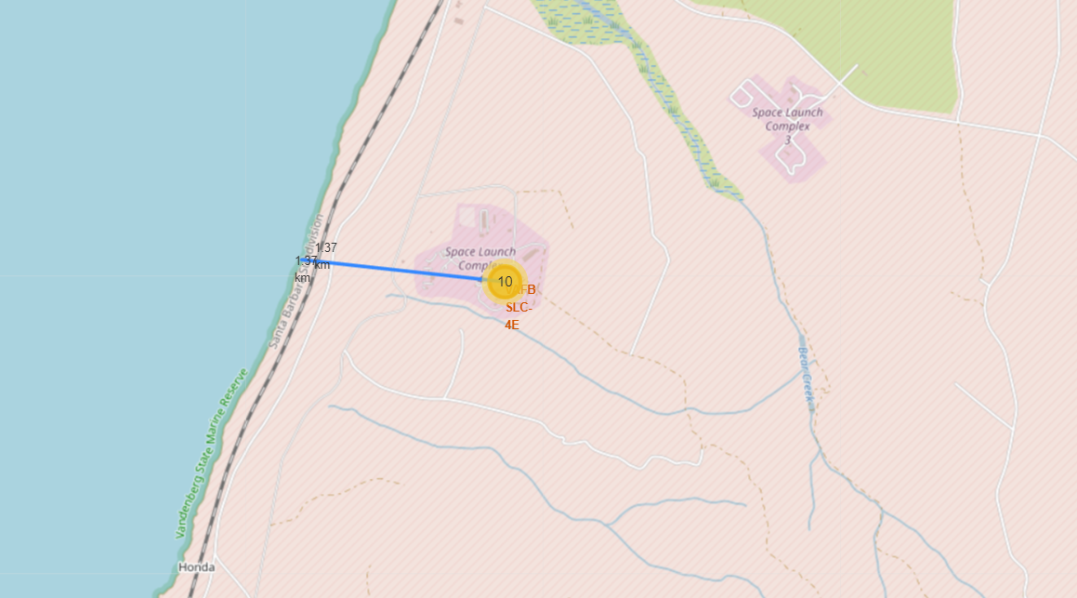
Distance to the Coastline
In this map we can see the distance (1.37km) to the coastline (Pacific Ocean) from the Launching Site of VABF-SLC 4.

Slide 38

Section 4

Slide 39
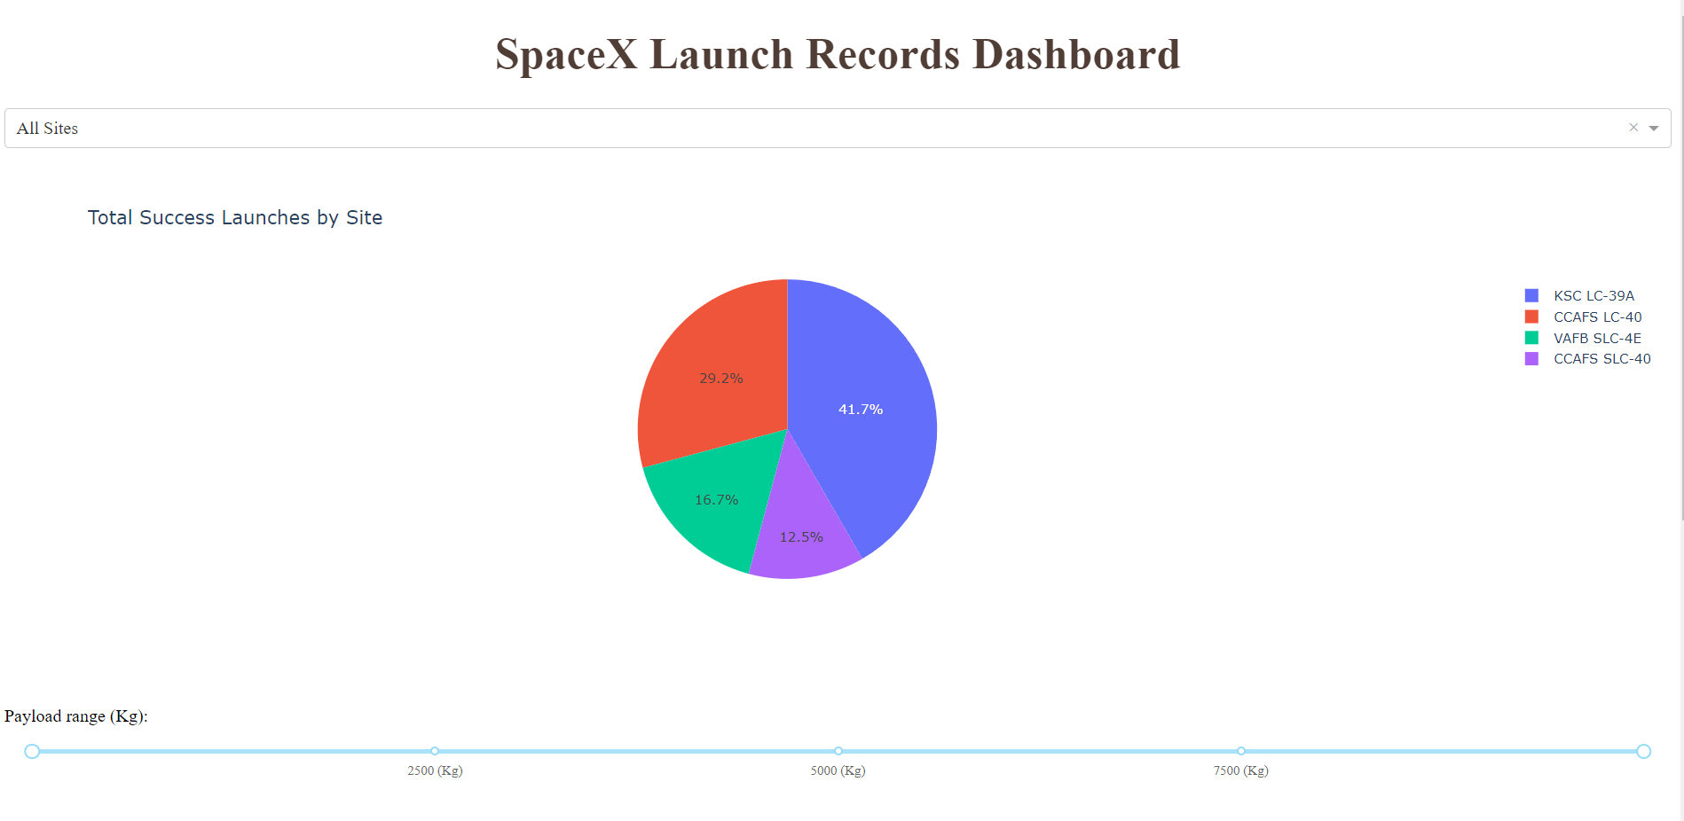
Successful Launches
This pie chart displays the distribution of successful launches across all sites. Both CCAFS SLC-40 and CCAFS LC-40 refeer to the same launching site so VAFB has the least successful launches rate with nearly 17%. KSLC has the most successful launches with more than 40%.

Slide 40
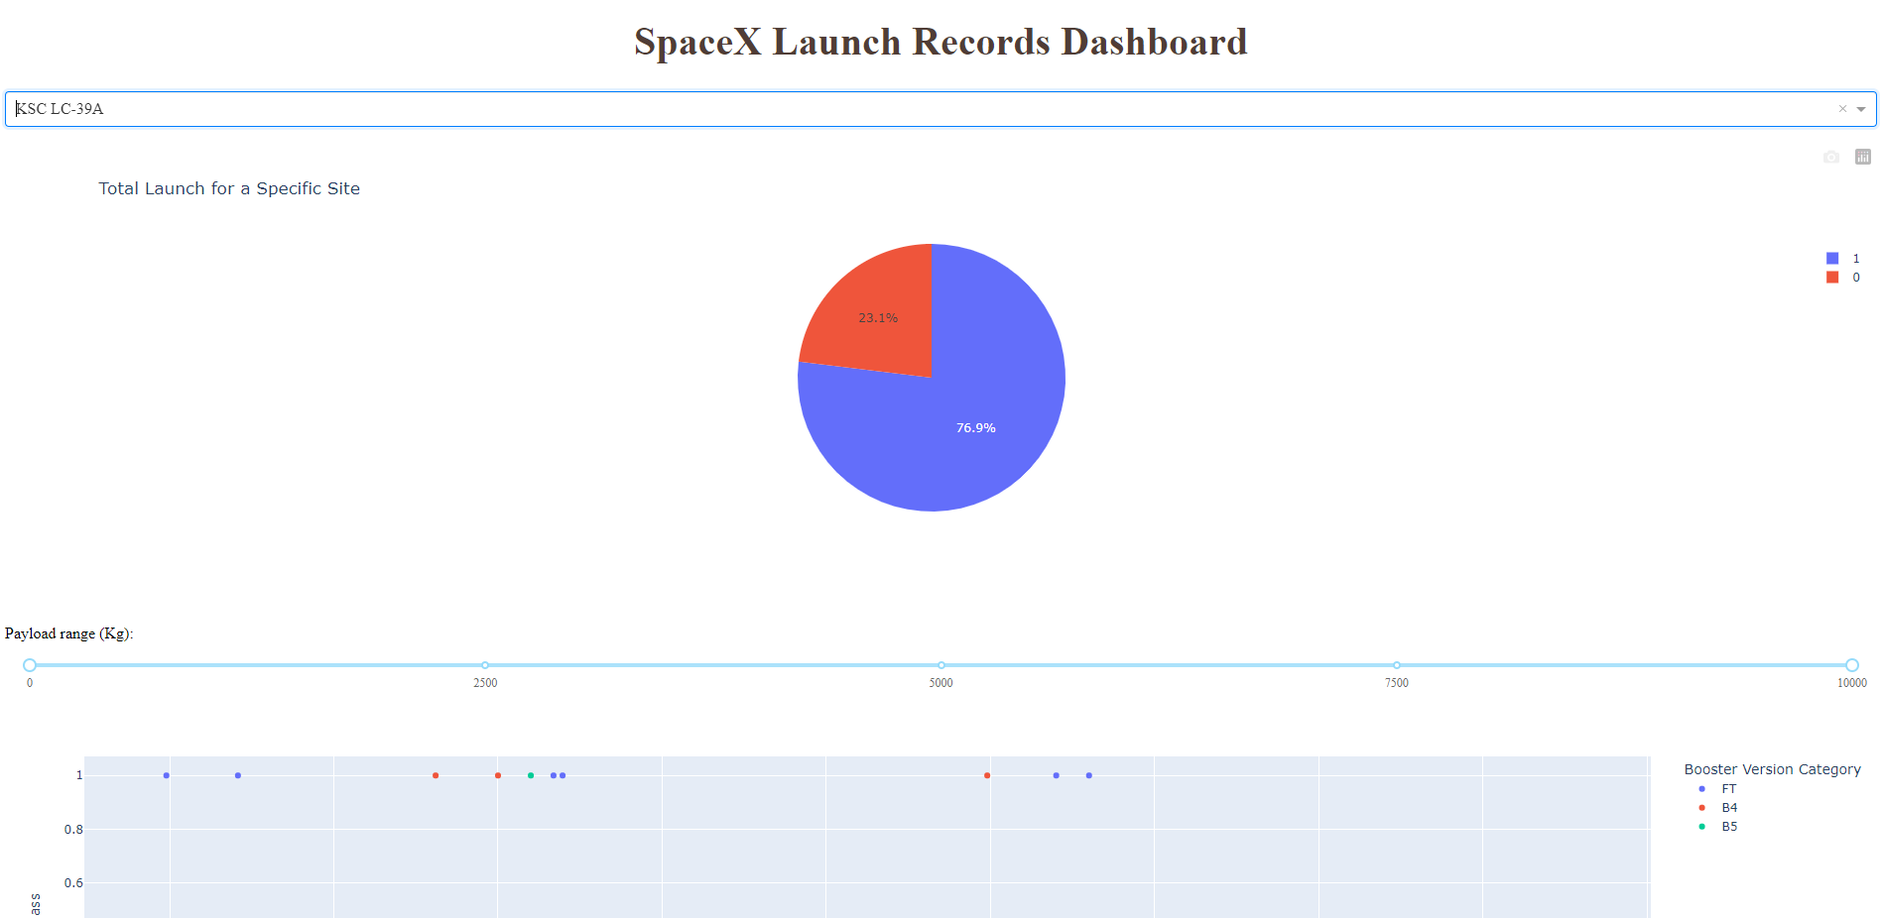
KSC LC-39A
For the highest successful launch site, KSC-LC-39A, we can see that the ratio is pretty high, with more than 75% of success rate.

Slide 41
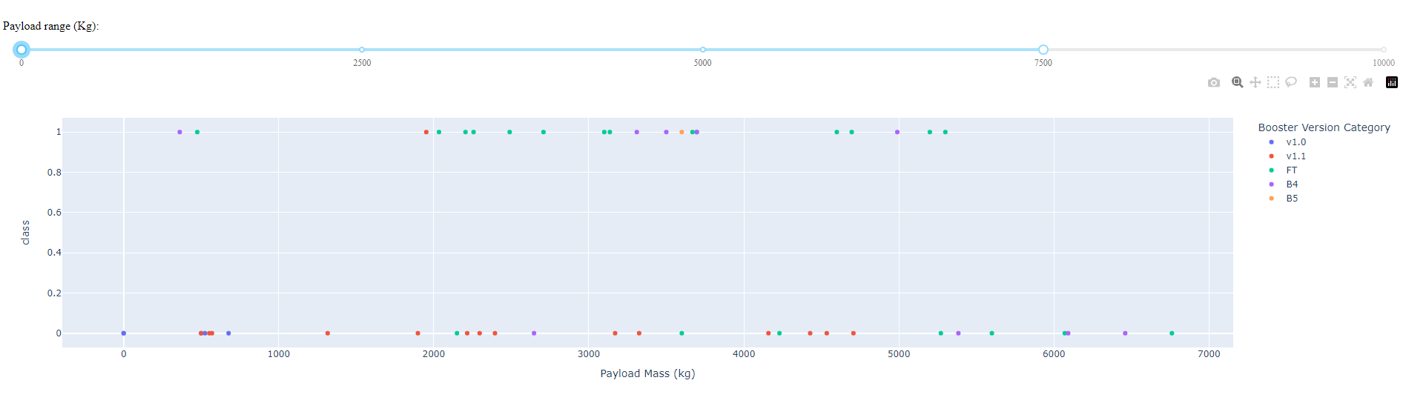
<Dashboard Screenshot 3>
Plotly dashboard has a Payload range selector. The maxium is set to 10000kg, although it should be setted at least to 16000kg. Class 1 indicates success, and 0 failure. The colors refer to booster version category.

Slide 42

Section 5

Slide 43
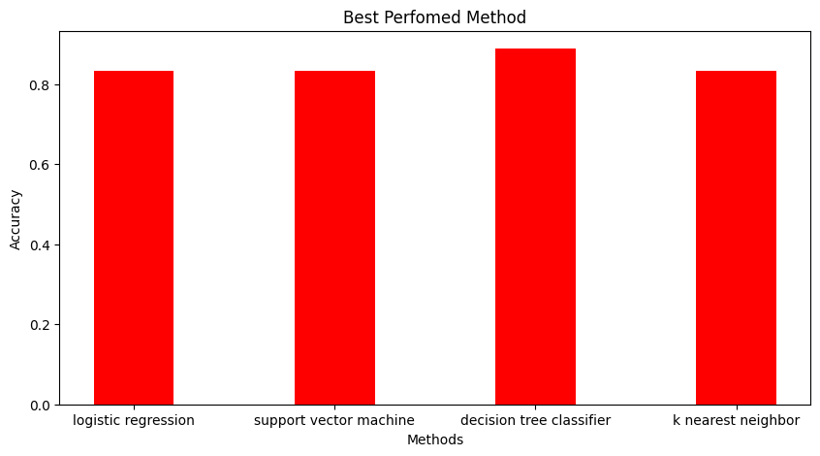
Classification Accuracy
We can see that in all models, Decision Tree has the most accuracy score with 88.8%. The other methods stay behind it with 83.3% all of them.

Slide 44

Confusion Matrix
Here we can see the confusion matrix of the decision Tree Classifier.
This model predicted correctly with no overfitting, having only 1 false positive (successful landing) and 1 false negative (failure).

Slide 45
Conclusions
Our task was to develop a machine learning model that can predict when Stage 1 will successfully land to save hundreds of million USD.
To do so, we used Space X public APIs and scrapped Wikipedia’s Space X page to gather information.
We extracted the data, analize it and wrangled using Python and SQL queries.
We created a dashboard and folium maps for visualization.
We created different machine leraning models and trained them with our already standardized data.
We saw the best model in Decission Tree Classifier, that give us nearly 90% of accuracy.
Further data would be useful to improve our model.

Slide 46
Appendix
Include any relevant assets like Python code snippets, SQL queries, charts, Notebook outputs, or data sets that you may have created during this project

Slide 47


